Slide 1
Flight Delay Times
IST 718 - Big Data Analytics
Charles Anyanwu, Yehuda Perry, Samantha Riedener, Himadri Tewari

Slide 2
Problem Statement
Use airline delay data to discover the following:
EDA to find where and how delays are occurring
Predict if a delay will happen and the length of the delay
Air travel is used by millions of people across the United States daily. Delays have the potential to impact each of those travelers, usually for the worse
By being able to understand delays it can be possible to find ways to avoid or mitigate them

Slide 3
About the Data
12,771,253 rows of data with 60 columns about flights that were delayed or departed early
2,673,761 rows represent delays (flights departing 15 or more minutes after their scheduled time) or cancellations
Examples of columns: Weather delay, carrier delay, NAS delay, security delay, late aircraft delay, departure time, year and month, carrier, origin and destination airports, etc.
Collected from Bureau of Transportation Statistics: https://www.transtats.bts.gov/OT_Delay/OT_DelayCause1.asp

Slide 4
Cleaning the Data
Data set that was ultimately used was not the one that we started with
Original data set had ~50,000 rows and was already aggregated
Each row did not represent one flight and was not suited for predictive algorithms
Size of new data set proved a challenge to work with, computationally
Data was split to only look at rows with delays to make it smaller and easier to work with
Data set contained a large number of outliers, delays that totalled over 3 hours, and many zeroes
This made some calculations difficult to carry out and find numbers genuinely representative of the data
Data was subsetted to limit departure delays to less than 3 hours
This helped in reducing the outlier noise, giving more realistic outputs
Final dataset size to start analysis with is 2,265,737

Slide 5
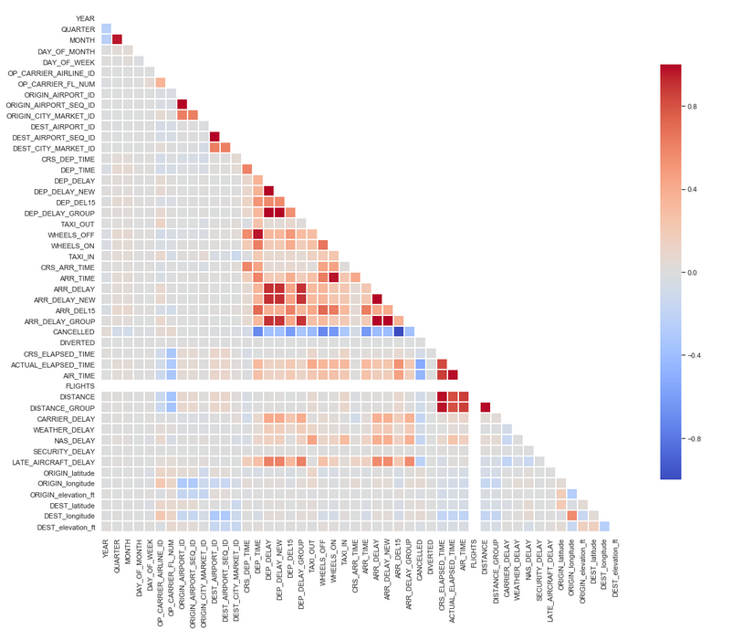
Data Exploration
Through the correlation matrix we can see how some of the variables in the dataset present multicollinearity, in other words, can be linearly predicted from the others.
To have a better analysis and work with a lighter dataset, we are going to delete some of those unwanted variables and create new ones.We can also make the following observations:
1. When Arrival Delay is longer than 15 minutes, there's data about what caused the delay.Arrival Delay is the sum of CarrierDelay, WeatherDelay, NASDelay and LateAircraftDelay. In cases of cancellation or diversion there's no data related to delay causes.
2. Airports and carriers allocate a CRSElapsedTime higher than the actual time spent in the Taxi In + Taxi out + Airtime operations (Actual Elapsed Time).This is the reason when planes take off on time, landing usually takes place before the expected time! It also allows to absorb delay by late aircraft down the lane of chained flights.

Slide 6
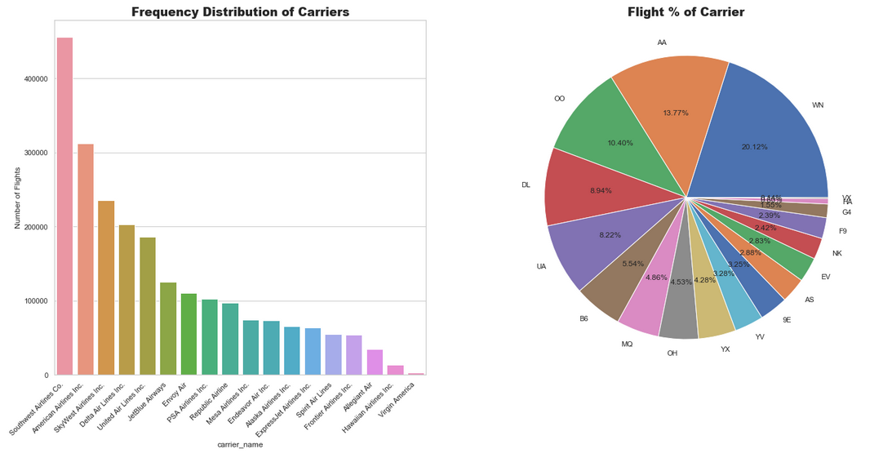
Data Exploration… Overall Data-Set

Slide 7
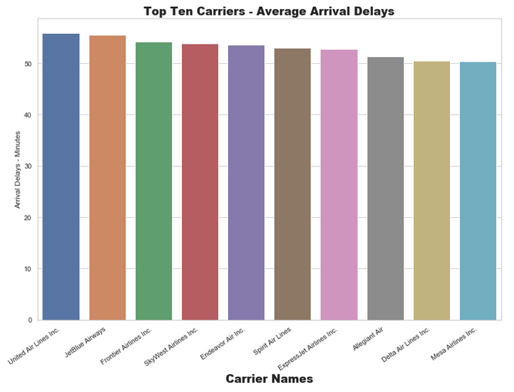
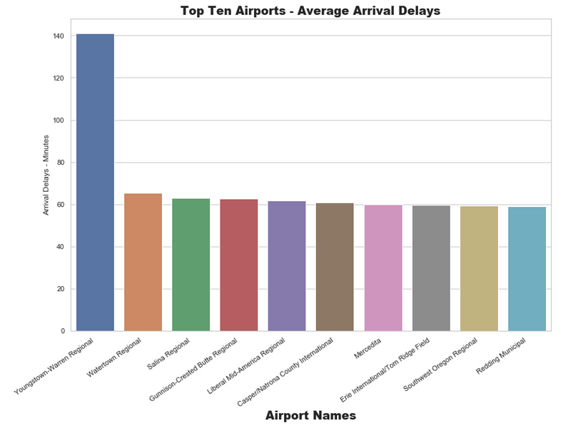
Data Exploration…Visualization of Arrival Delays
Visualization of Arrival Delays

Slide 8
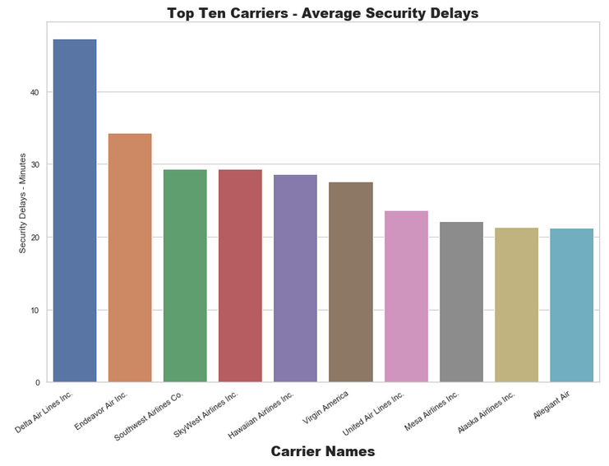
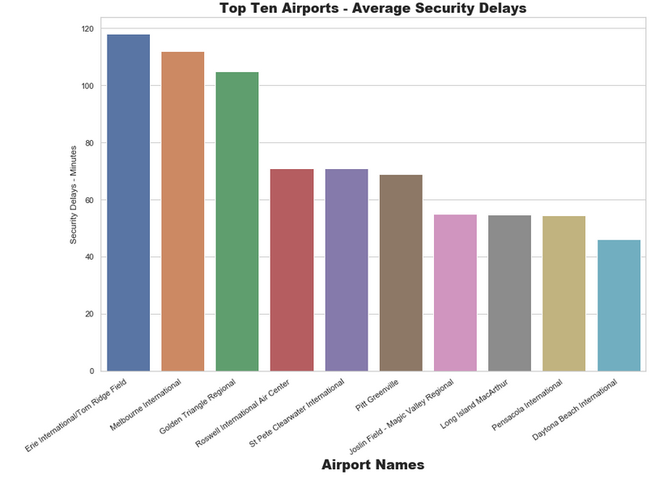
Data Exploration…Visualization of Security Delays
Visualization of Security Delays

Slide 9
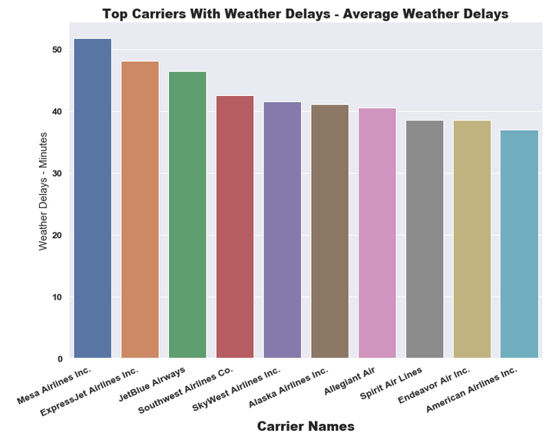
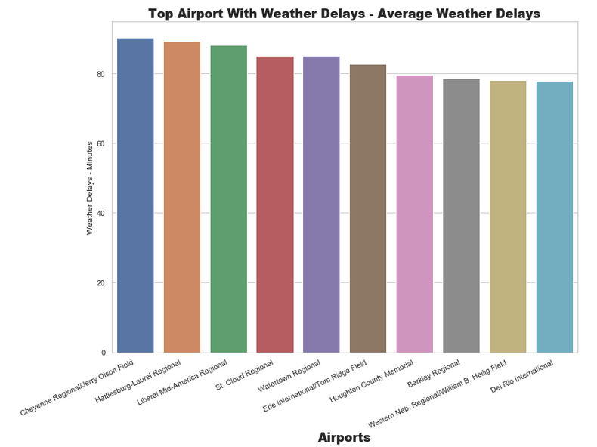
Data Exploration…Visualization of Weather Delays
Visualization of Weather Delays

Slide 10
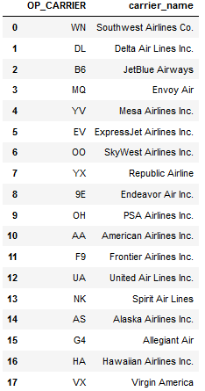
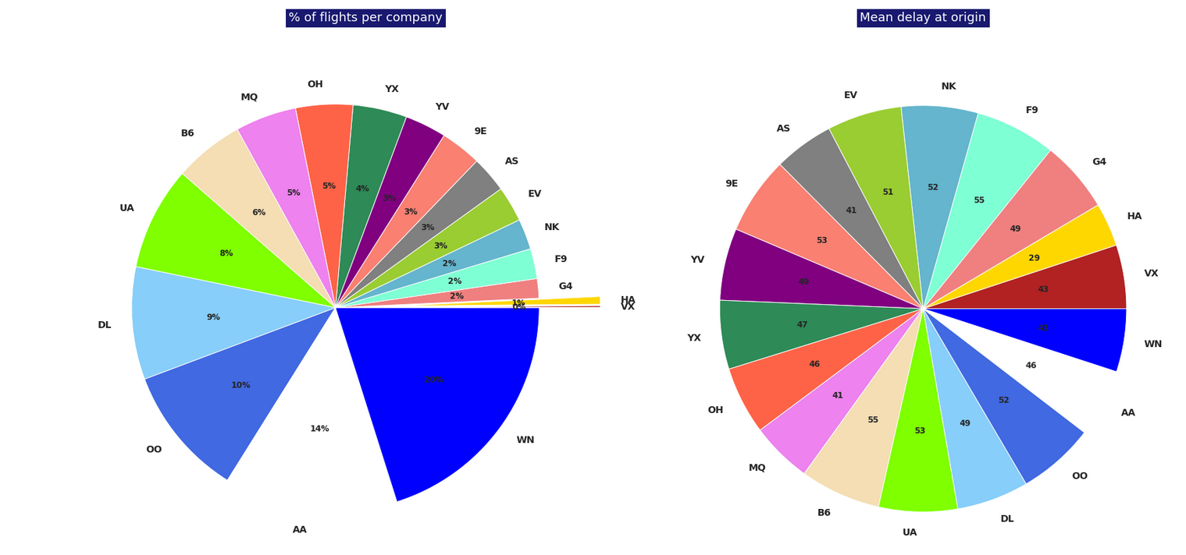
Data Exploration…Visualization
First pie chart gives the percentage of flights per airline carrier, this shows some disparity between the carriers.
- For instance, Southwest Airlines accounts for ∼20% of the flights which is similar to the number of flights chartered by the 7 smallest airlines.
- The second pie chart, shows the differences among airlines are less pronounced.
- Excluding Hawaiian Airlines and Alaska Airlines that report lower mean delays than their counterparts.
- As of 2018 and 2019, all airlines run about 45 mins delay on average. This seems to be the new norm.

Slide 11
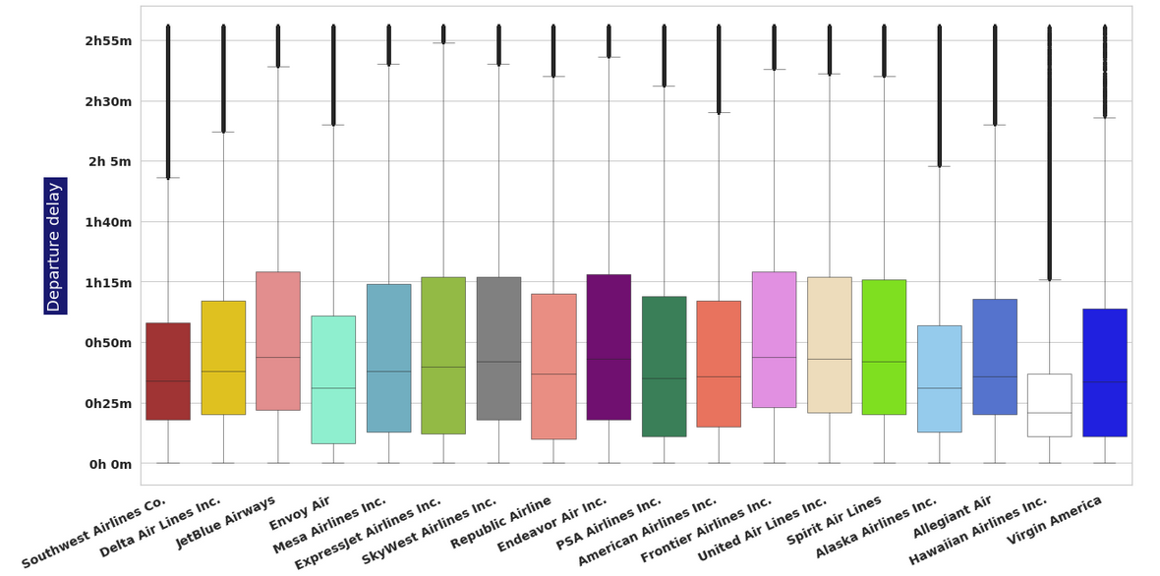
Data Exploration…Boxplot
Boxplot is a measure of all the delays from January 2018. This shows the relative homogeneity that appeared in the second pie chart above.
Restricted to 180 minutes

Slide 12
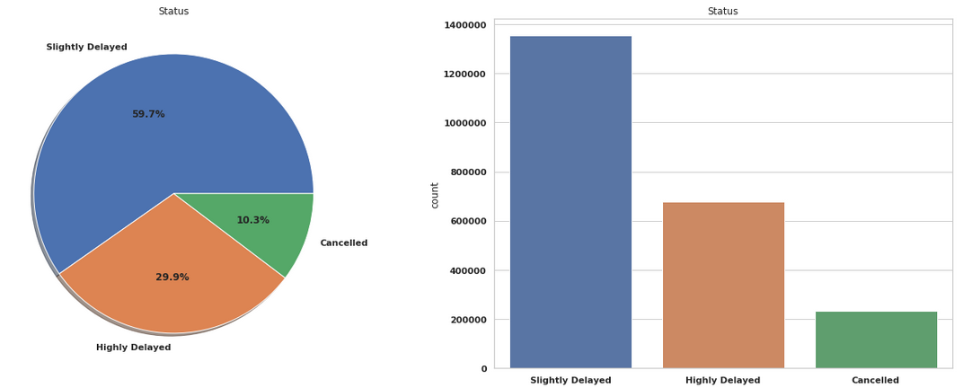
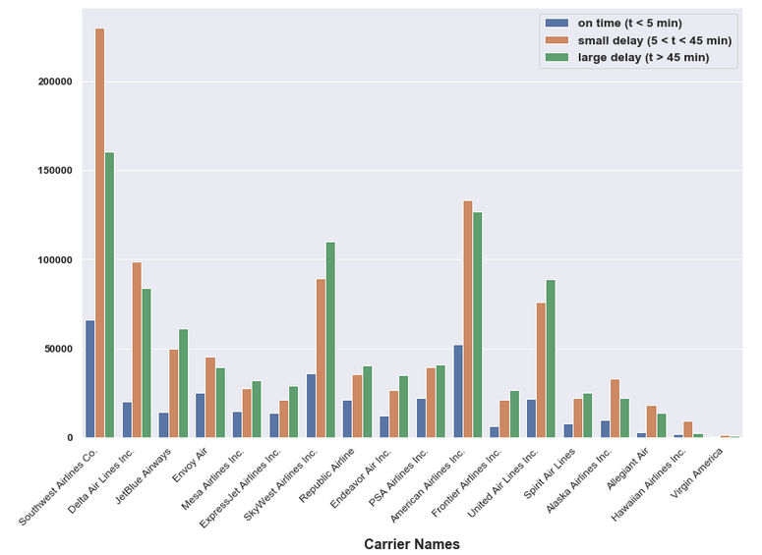
Data Exploration…Visualization
Carrier Visualization of how departure delays are grouped

Slide 13
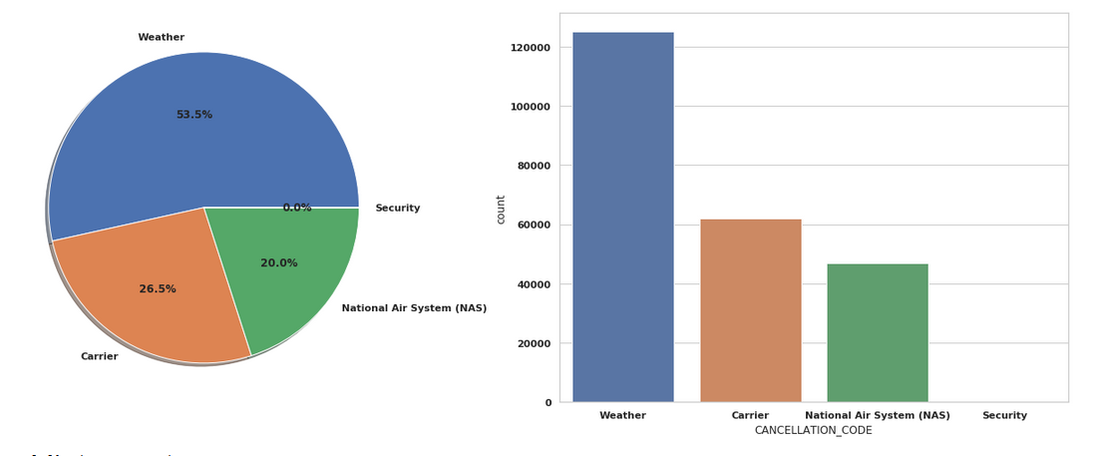
Data Exploration…Visualization
Reasons for cancellation

Slide 14
Linear Regression
Can delay times be predicted with linear regression?
Which variables are statistically significant and therefore are most likely to contribute to a delay?
Delay types investigated individually due to how the data set is organized

Slide 15
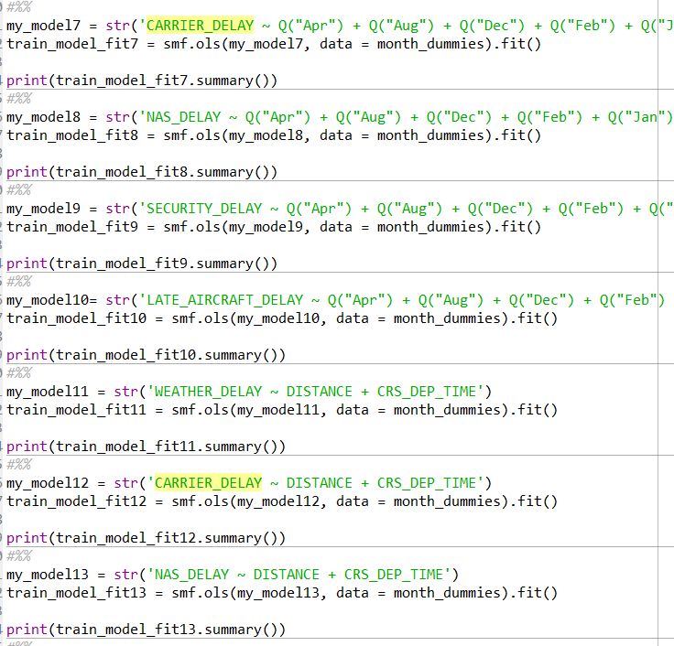
Linear Regression - Methods
Dummy variables for month and carrier were created to see their effects
A different model for each of the 5 delays types needs to be built to avoid collinearity with DEP_DELAY variable
Models were built iteratively to try and find the best combination of significant variables

Slide 16
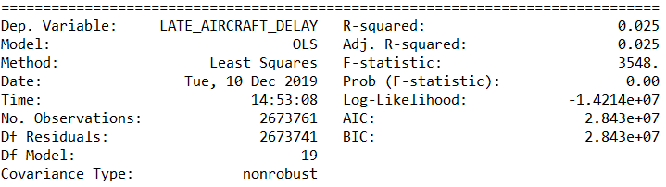
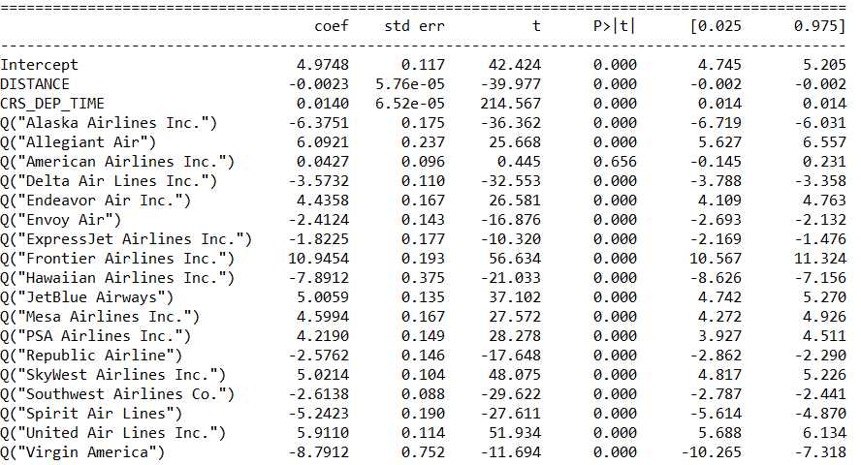
Linear Regression - Results
Significant variables were found, but no strong models could be built
Data set most likely doesn’t have the correct variables to explain the variance in the output
Additional variables to describe weather conditions pr scheduling could be useful
Exploring airport location could also lead to further insights

Slide 17
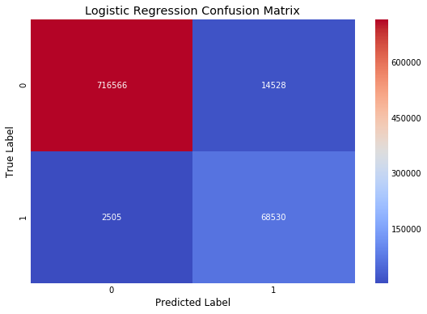
Logistic Regression - Airline Cancel
Cancelled variable is considered as the response variable.
Independent variables considered are - Month, Departure Time, Scheduled Departure Time, Scheduled Arrival Time, Air Time, Distance and Unique Carrier.
Accuracy - 98%
Notes:
As part of the model creation, first a correlation matrix was plotted to find out if any of the variables have strong correlation.
Air Time and Distance have strong correlation. To avoid Multicollinearity, Air Time variable was removed.
Scheduled Departure Time was not normally distributed. It was transformed using Box-Cox transformation and stored in a new variable - Scheduled Departure Time Transform.
To simplify the dataset, Scheduled Departure Time variable is removed.
For feature creation, Unique Carrier variable was used and was replaced with dummy variables.
For model creation, train and test dataset was created where 30% of the data used as test set and the remaining as training set.
Cancelled variable (dependent variable) was removed from the dataset.
To avoid overfitting the model, stratified k-fold cross validation was used on the training dataset using 10 folds
For logistic regression, all the independent variables were used. As the dependent variable was not evenly distributed, balancing weight was used.
The accuracy score achieved using the model on the test set was 98%.
Referring to the confusion matrix, the model produced lot of True Positive and True Negative. It appears that this model may be predicting too many flight cancellations.
In future scope, the model weight needs to be adjusted.

Slide 18
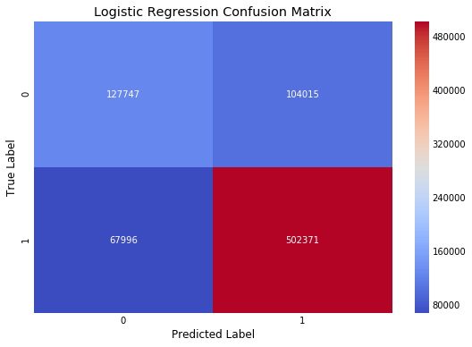
Logistic Regression - Airline Departure Delay
Departure Delay by 15 minutes variable is considered as the response variable.
Independent variables considered are - Month, Departure Time, Scheduled Departure Time, Scheduled Arrival Time, Air Time, Distance and Unique Carrier.
Accuracy - 78%
Notes:
As part of the model creation, first a correlation matrix was plotted to find out if any of the variables have strong correlation.
Air Time and Distance have strong correlation. To avoid Multicollinearity, Air Time variable was removed.
Scheduled Departure Time was not normally distributed. It was transformed using Box-Cox transformation and stored in a new variable - Scheduled Departure Time Transform.
To simplify the dataset, Scheduled Departure Time variable is removed.
For feature creation, Unique Carrier variable was used and was replaced with dummy variables.
For model creation, train and test dataset was created where 30% of the data used as test set and the remaining as training set.
Departure Delay by 15 minutes variable (dependent variable) was removed from the dataset.
To avoid overfitting the model, stratified k-fold cross validation was used on the training dataset using 10 folds
For logistic regression, all the independent variables were used. As the dependent variable was not evenly distributed, balancing weight was used.
The accuracy score achieved using the model on the test set was 78%.
Referring to the confusion matrix, the model produced lot of True Positive and True Negative. It appears that this model may be predicting too many flight cancellations.
In future scope, the model weight needs to be adjusted.

Slide 19
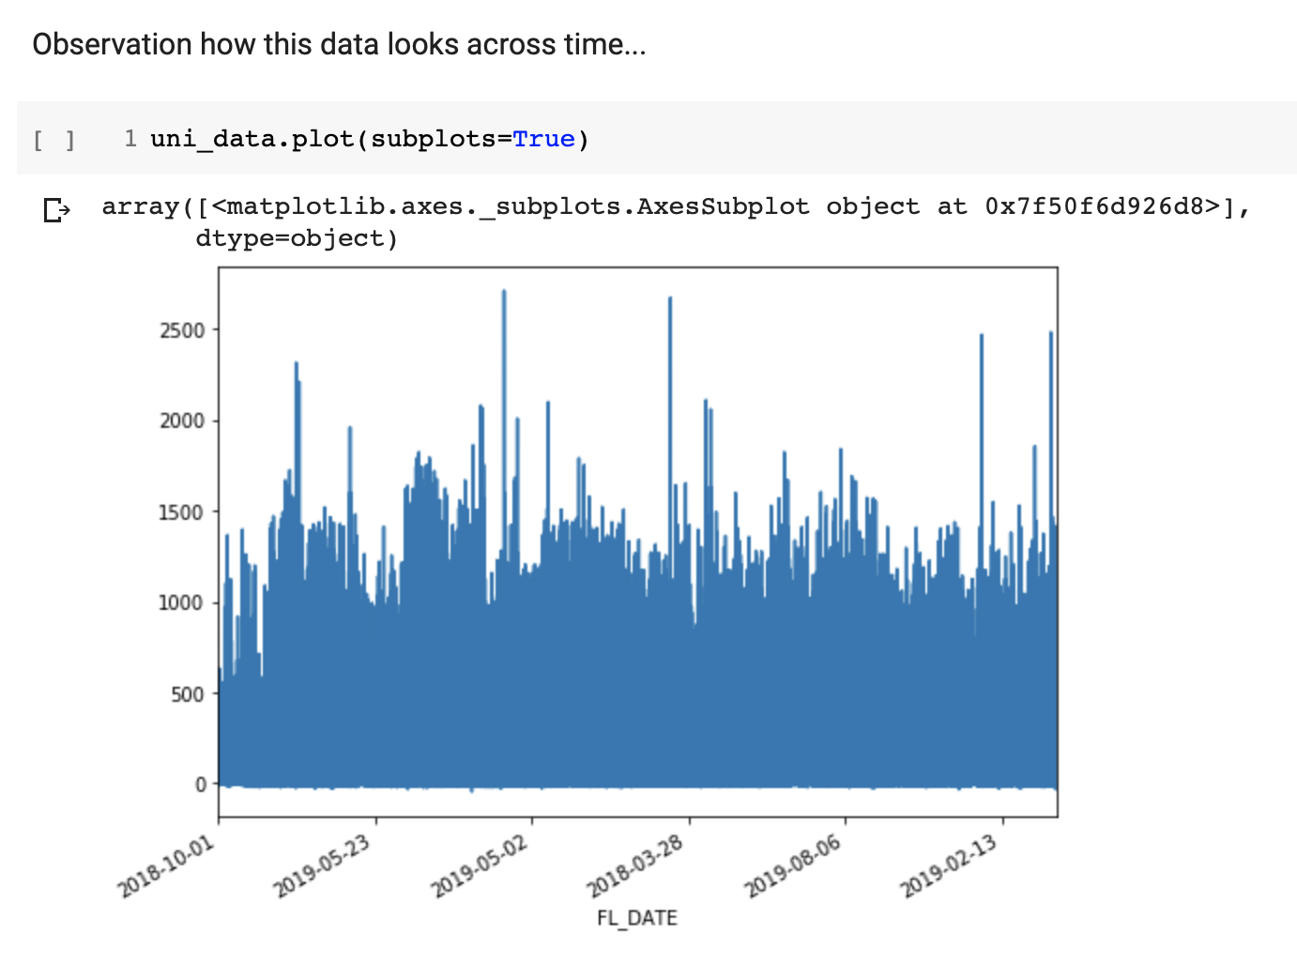
TensorFlow: Time Series

Slide 20
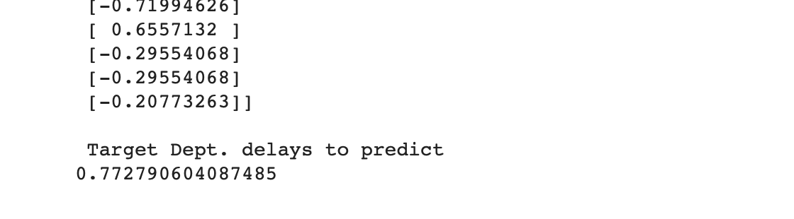
TensorFlow: Time Series

Slide 21
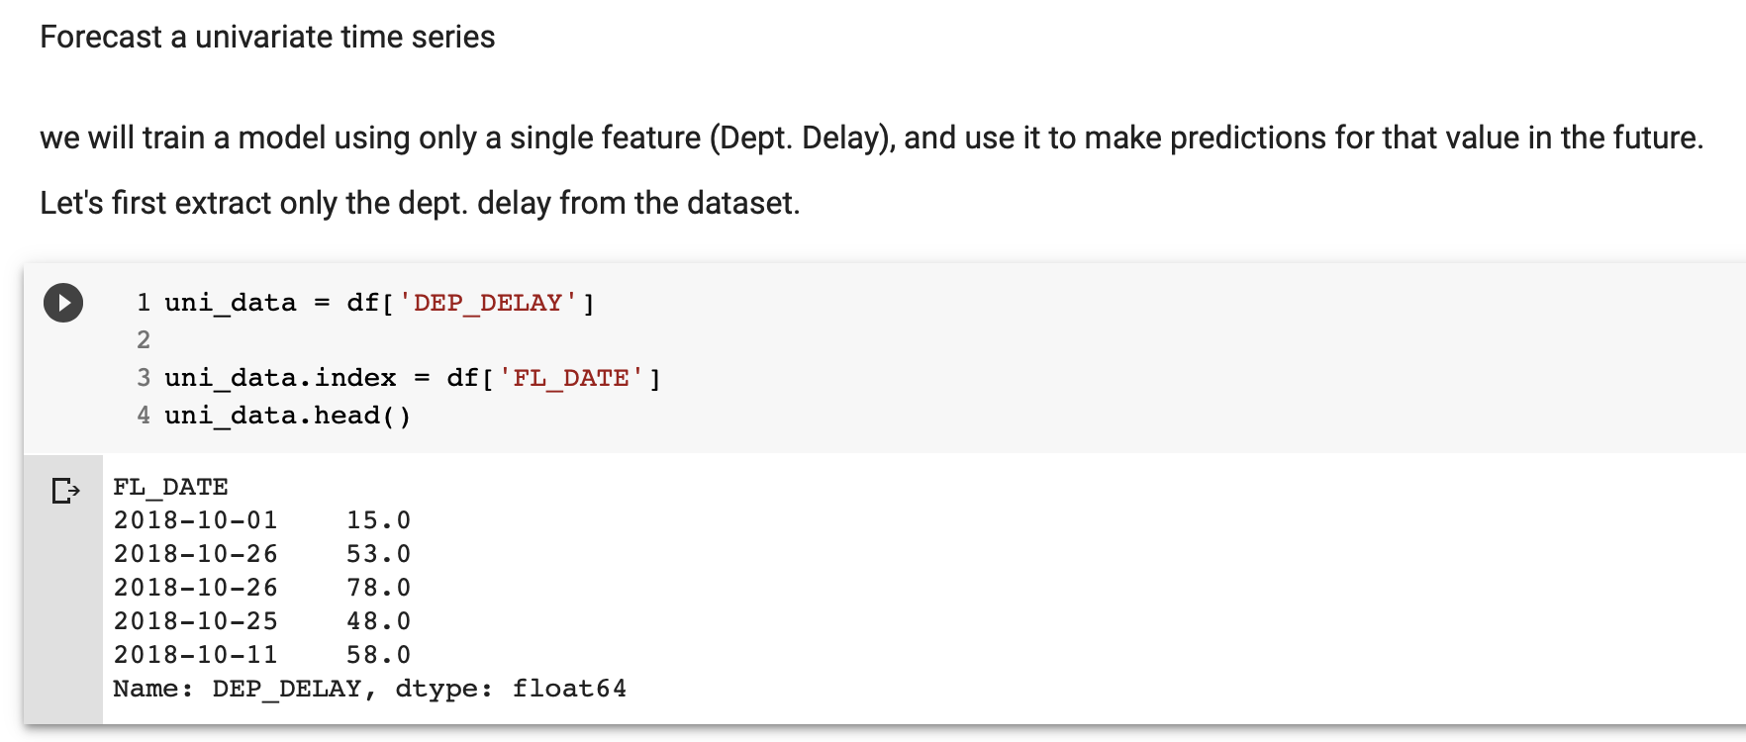
TensorFlow: Time Series

Slide 22
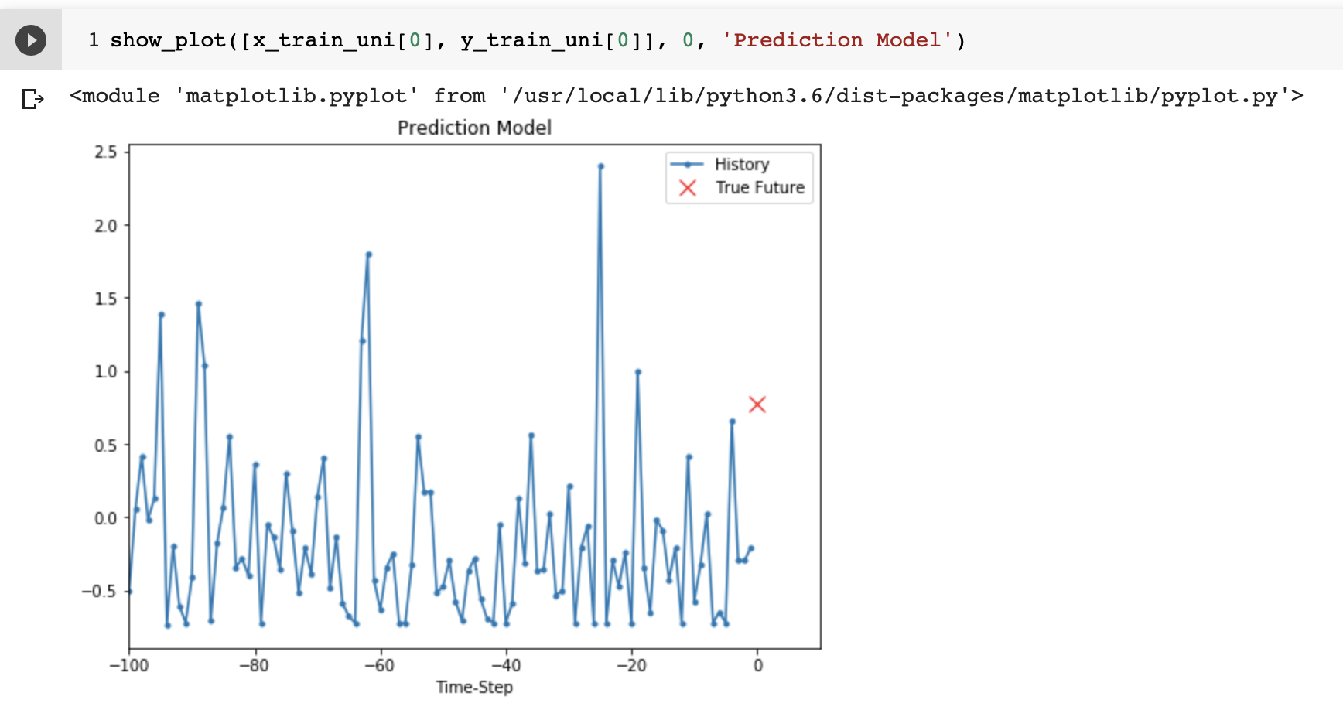
TensorFlow: Time Series

Slide 23
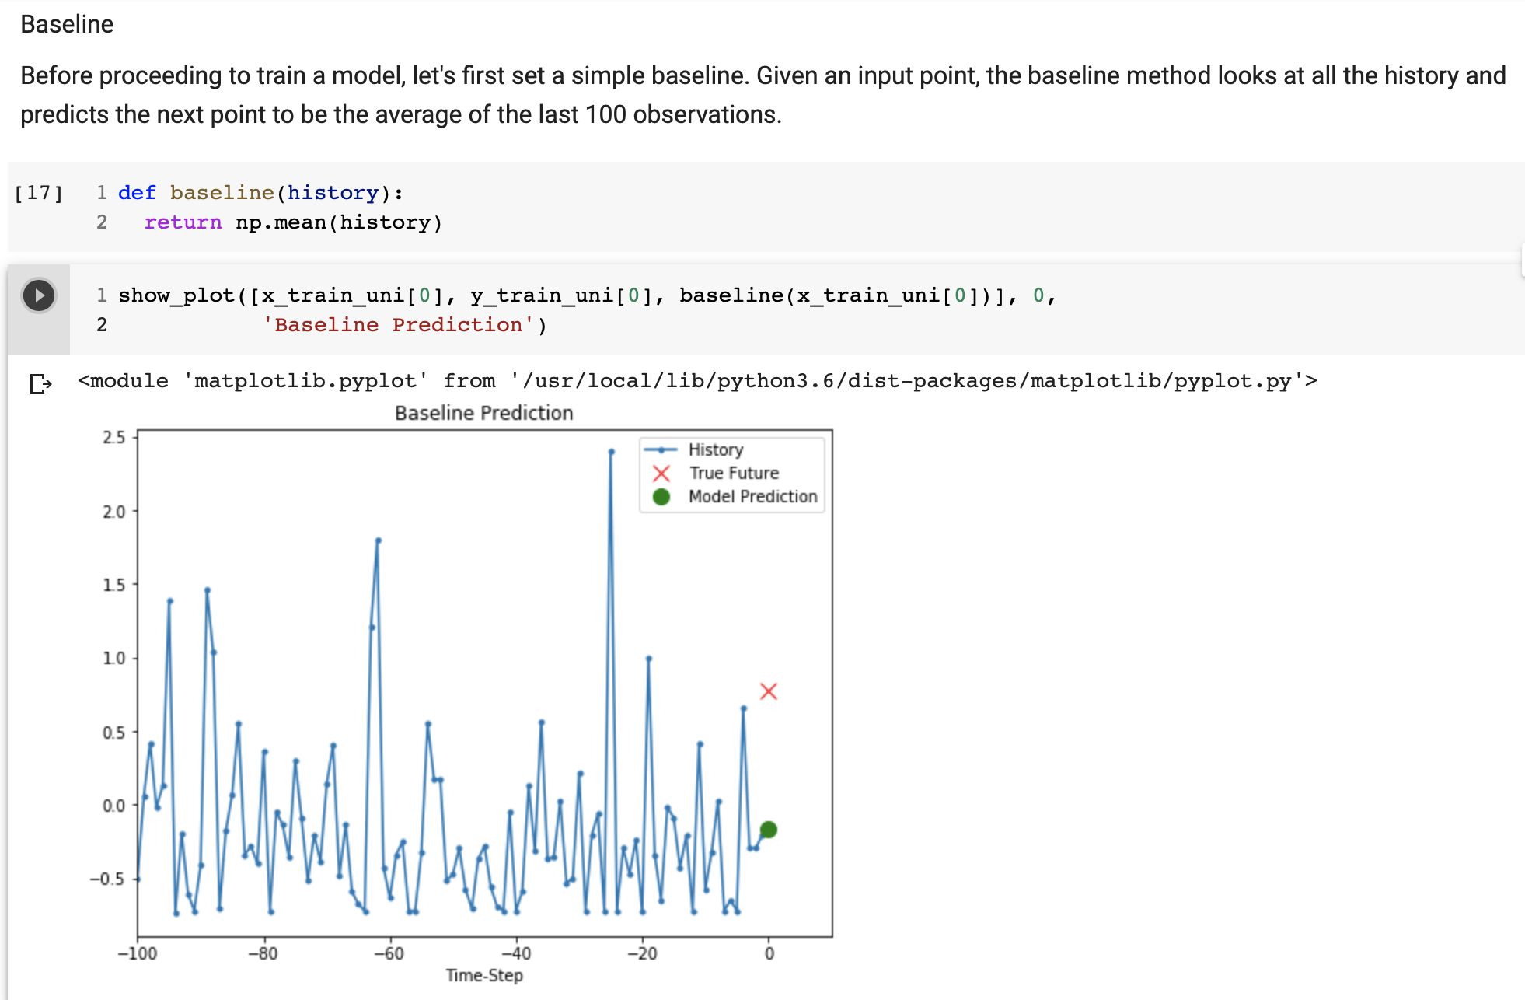
TensorFlow: Time Series

Slide 24
TensorFlow: RNN (Recurrent Neural Network)

Slide 25
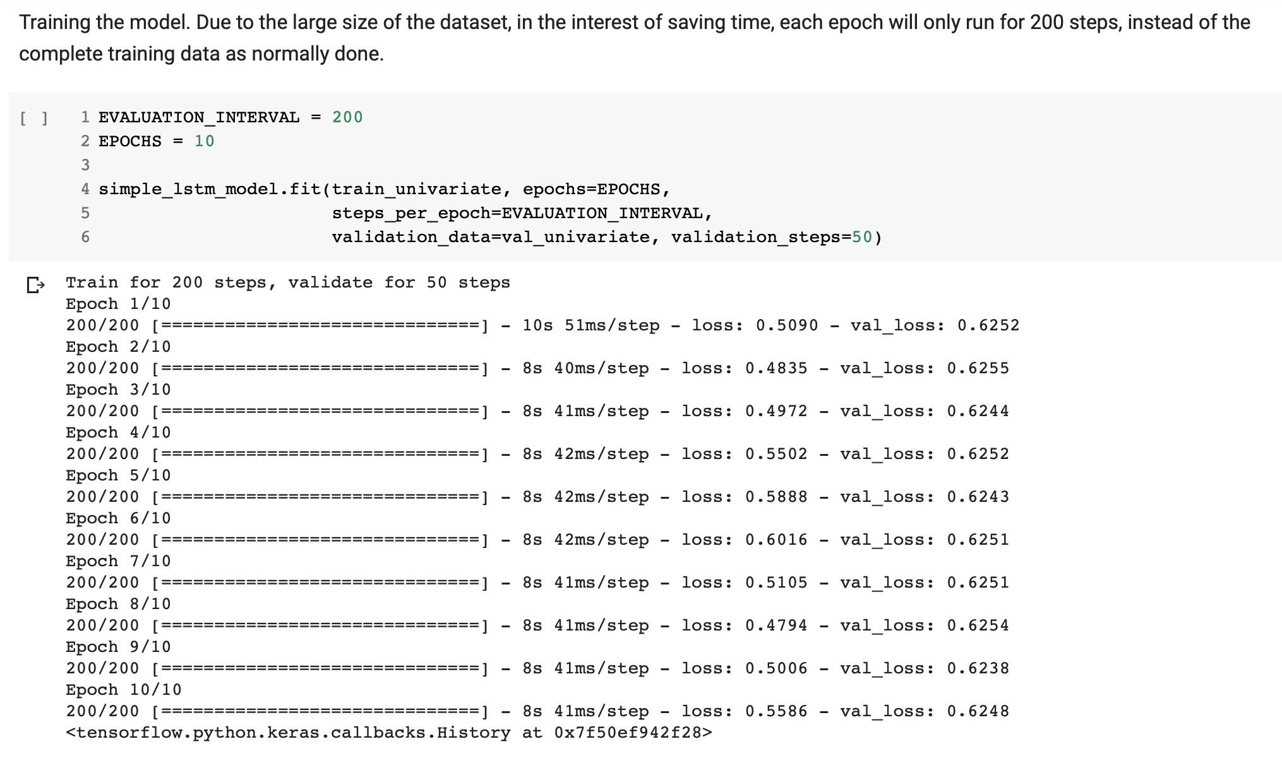
TensorFlow: RNN (Recurrent Neural Network)

Slide 26
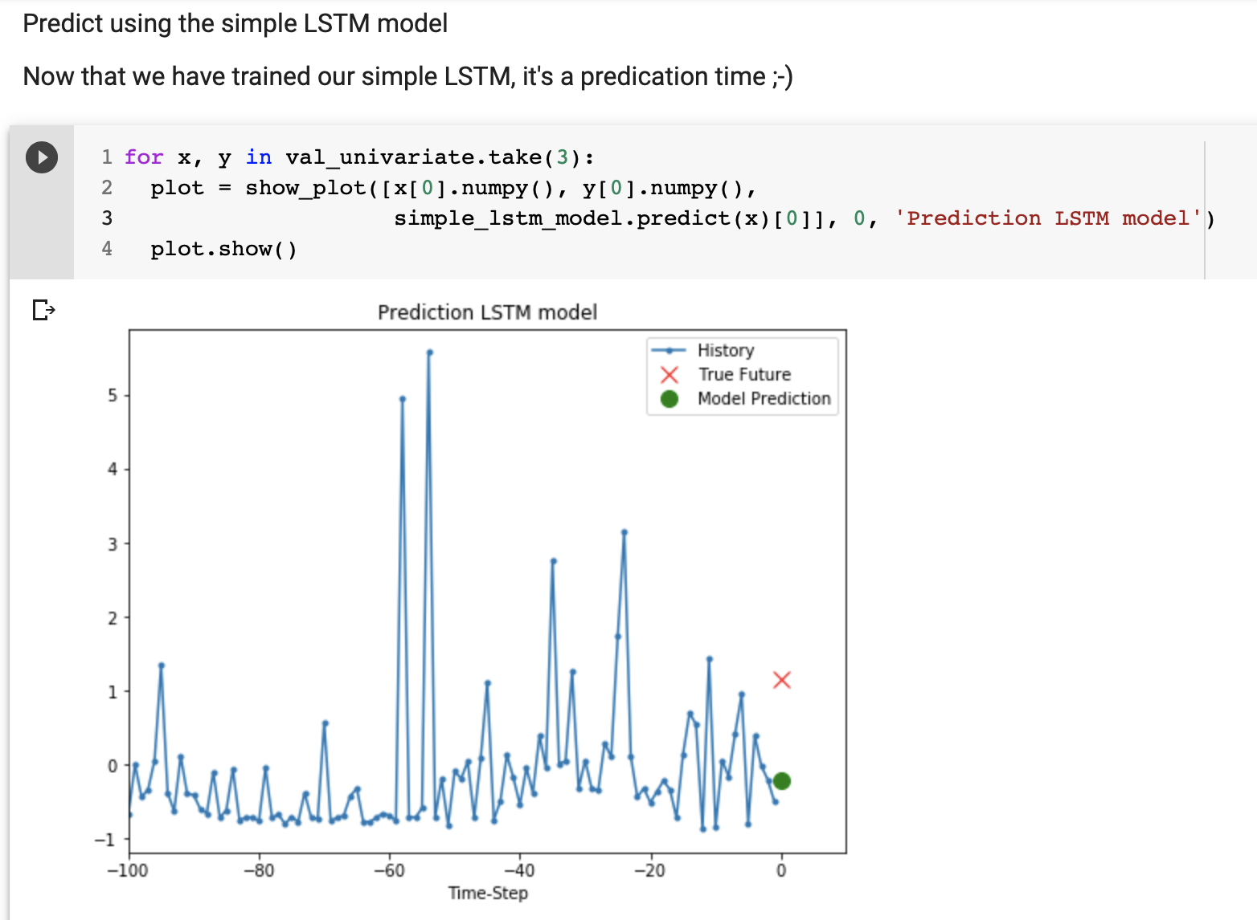
TensorFlow: RNN (LTSM Model)

Slide 27
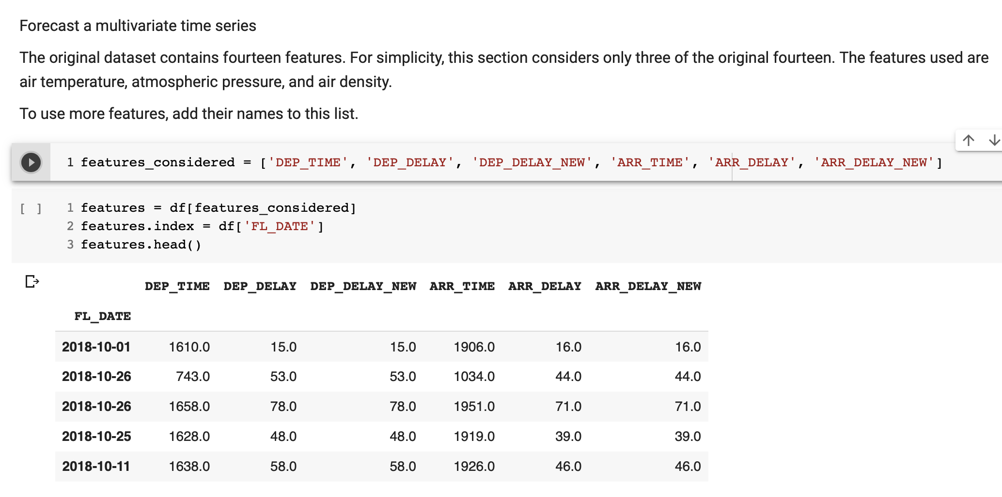
TensorFlow: Forecast Multivariate Time Series

Slide 28
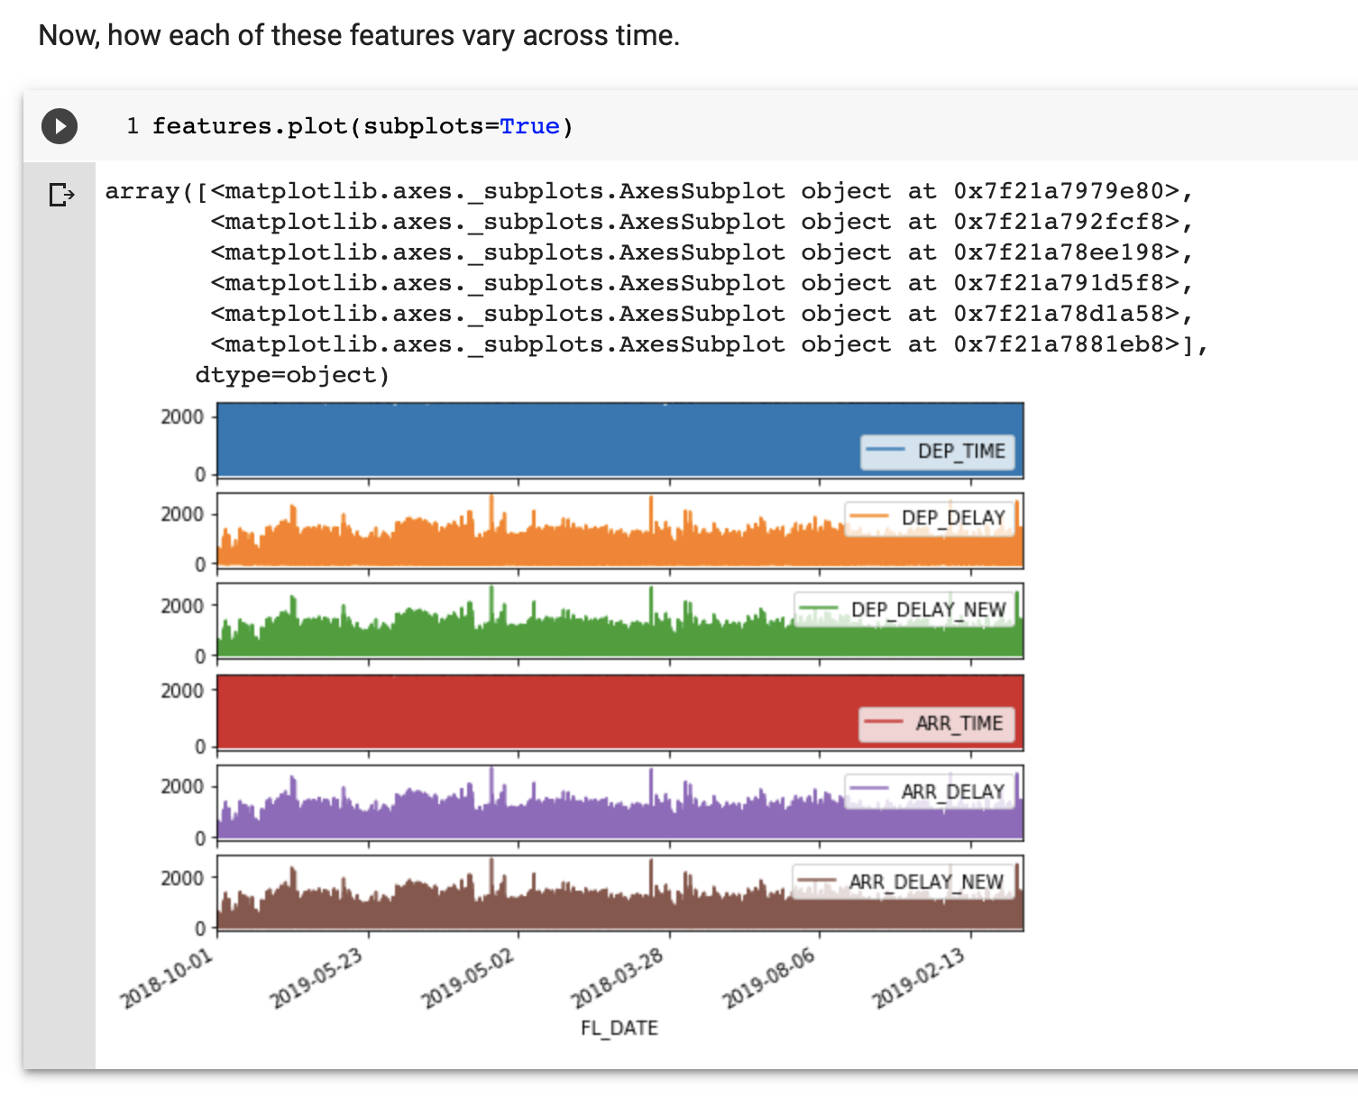
TensorFlow: Forecast Multivariate Time Series

Slide 29
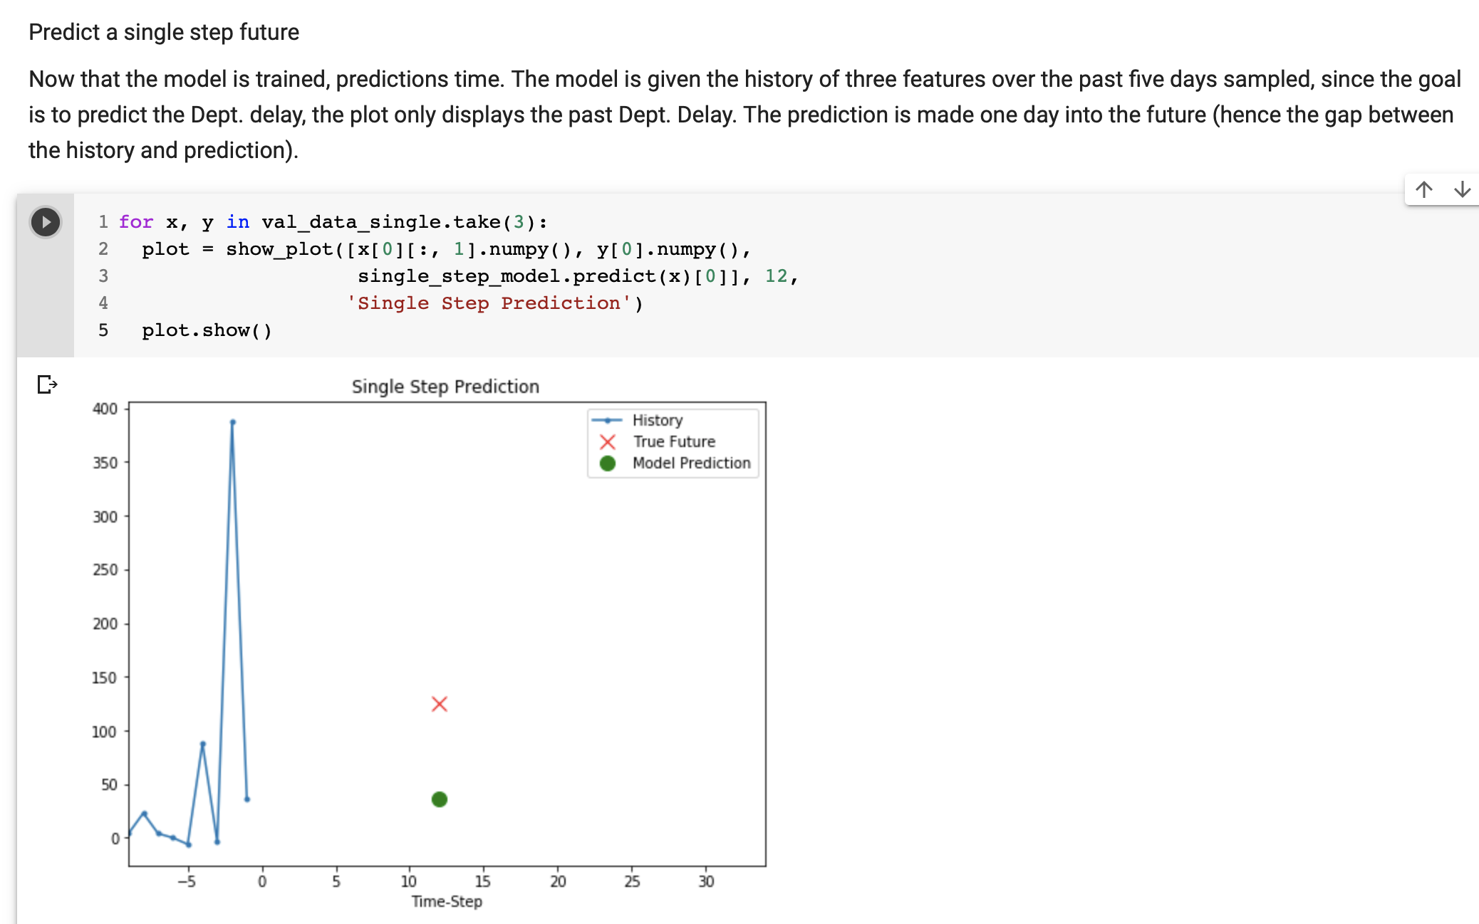
TensorFlow: Forecast Multivariate Time Series

Slide 30
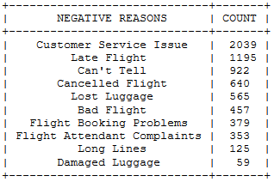
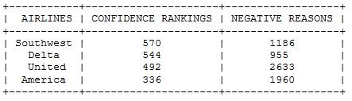
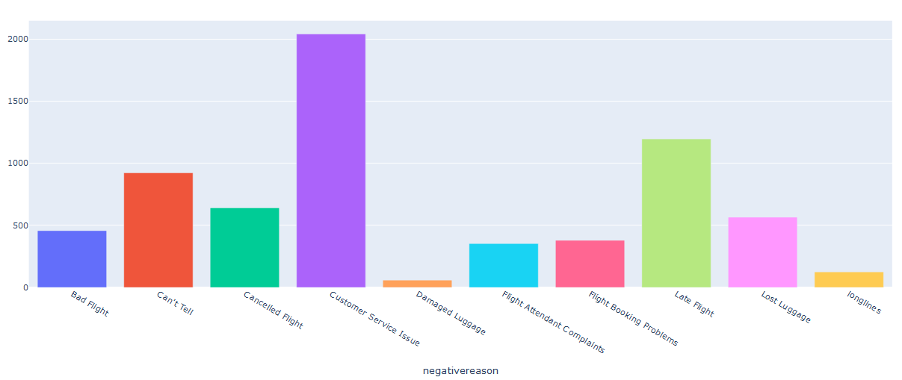
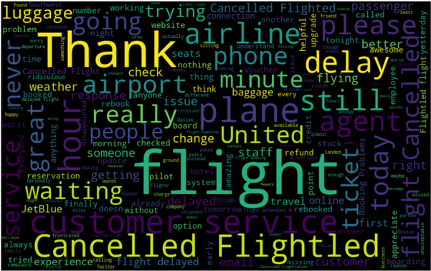
Sentiment Analysis: Comparison
Dataset from Kaggle (14,640 rows)
Subsetted based on project data EDA of carriers with major delays. (11223 rows)
United, Southwest, Delta, and American airlines
Ranking match trends in project data
Correlation between reasonable security delays and confidence rankings
Reasons for Negative Sentiment

Slide 31
Recommendations
Many causes for delays are out of the control of airports and airlines; the largest cause of negative sentiment was poor customer service. By focusing on customer service relations this can minimize negative customer feelings and is something well within the control of airlines
More delays occur on the arrival end of airports. This part of the process is where efforts should be focused to minimize delays
For future analysis, weather data would help focus in on weather based delays

